Slide 1






JavaScript for Front-End
Course Overview
JavaScript
for Front-End
SoftUni Team
Technical Trainers
Software University
http://softuni.bg

Slide 2

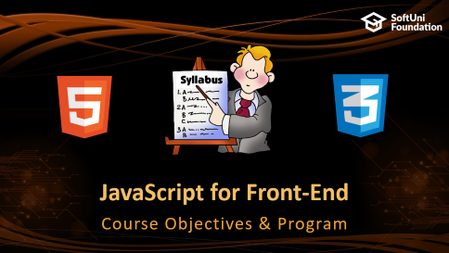



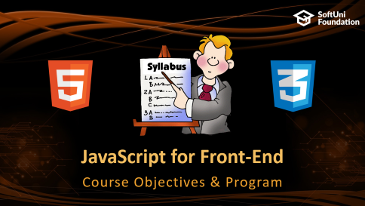


Table of Contents

Slide 3
Have a Question?
sli.do #front-end

Slide 4






SoftUni Diamond Partners

Slide 5






SoftUni Diamond Partners

Slide 6



JavaScript for Front-End
Course Objectives & Program

Slide 7
JavaScript – Course Topics
Introduction to JavaScript - Basic Syntax, Arrays, Functions, Objects, JSON
Introduction to DOM & Events - Explanation of DOM, Selectors, DOM Manipulation, Events
Introduction to jQuery - Selecting elements, Manipulating the DOM, Changing CSS
jQuery Plugins - Slick Slider, Datetime picker, Validator, Drag and drop
Introduction to AJAX - JQuery Ajax Concept, Requests, HTTP

Slide 8
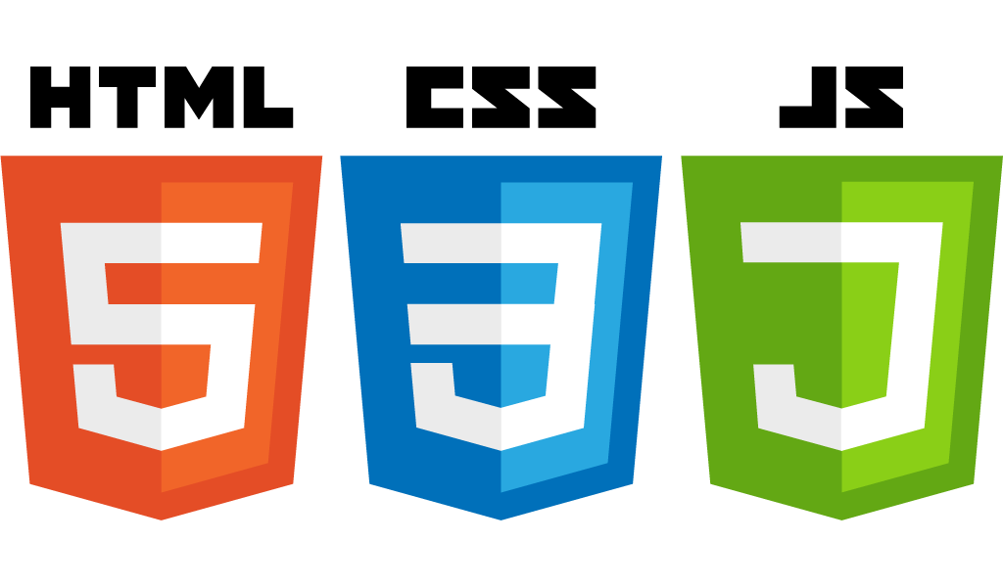
JavaScript – Course Topics (2)
Introduction to Bootstrap - Intro to Bootstrap, Grids, Forms, Buttons, Layout
Bootstrap Plugins - Introduction to plugins, Sliders, Datepicker, Validation
Workshop
Exam Preparation
Practical Exam

Slide 9

The Trainers Team

Slide 10

Trainers Team
Antonia Atanasova
Experience in HTML5, CSS3, JS, Bootstrap, C#, CMS Systems
Studies Software Engineering @ SoftUni
Studies Business Informatics @ UNWE
Technical Trainer in Software University
Digital Marketing Freelancer

Slide 11

Trainers Team
Yuliyan Ivanov
Experience in HTML5, CSS3, JS, C#, Bootstrap, MongoDB
Student with excellent grades at SoftUni
Experience : Personal projects with JavaScript, Owned a virtual items trading website

Slide 12

JS for Front-End: More Details
Duration, Languages, Technologies

Slide 13


Training Duration – JS for Front-End
Lessons: ~ 35 hours (onsite + YouTube videos)
Practical exercises (in class): ~ 40 hours
Homework: ~ 40 hours
Exam preparation: 8 hours
Exam: 6 hours
Schedule: July – August 2018
Exam date: 12 August 2018

Slide 14


Why English?
Why the slides are in English?
English is the native language of the software engineers
Specific terminology should be in English
Translations are inaccurate and funny
Just learn English!
No excuses

Slide 15



Learn to Search in Internet & Find Solutions!
The course assignments require to search in Internet
This is an important part of the learning process
Some exercises intentionally have no hints
Learn to find solutions!
Software development includes everyday searching and learning
No excuses, just learn to study!
Developers learn new technologies, tools, languages every day!

Slide 16

Evaluation

Slide 17


Scoring System for the Course
Mandatory:
Final exam – 90%
Homework submissions – 10%
Bonuses:
Presence in class – 5% bonus
Forum activity – bonus up to 5%

Slide 18
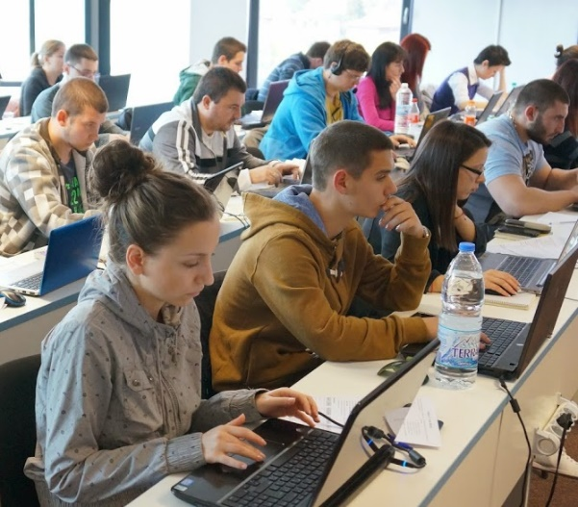

JavaScript for Front-End Exam
Practical JavaScript application exam
2 problems for 6 hours
Designing a web page from scratch with Bootstrap
Implementing dynamic functionality on the page with JavaScript

Slide 19

Homework Assignments
Doing your homework is very important!
HTML and CSS can only be learned through a lot of practice!
You should write code every day!
Each lesson is followed by a few exercises
Try to solve them in class
The rest are your homework
Homework assignments are due in 6 days after each lesson

Slide 20



Resources
What We Need Additionally?

Slide 21



JavaScript Course Web Site, Forum and FB Group
Official website:
Official discussion forum:
Official Facebook groups:
https://softuni.bg/courses/javascript-for-front-end
https://softuni.bg/forum/categories/68/web-basics
https://www.facebook.com/groups/SoftUniJavaScriptForFrontEndJuly2018/

Slide 22


The Front-End Development Slides and Videos
All lecture slides, videos, homework assignments, projects and other resources are open content, available for free
Visit the course website to access the course resources

Slide 23

Software University Learning System (SULS)
Software University Learning System (SULS)
www.softuni.bg
Important resource for students
Homework submissions
Homework check-up
Exams and results
Reports about your progress

Slide 24





Recommended Software
You will need a good IDE like:
WebStorm
Visual Studio Code
Brackets
Microsoft Visual Studio

Slide 25


Summary
The “JavaScript for Front-End" course teaches
The first steps in JavaScript
Training curriculum
Basic Syntax, JSON, Objects, Libraries etc.
Practical exam
2 problems for 6 hours
Learning resources
Slides, videos, software, books, forum

Slide 26







JavaScript for Front-end – Course Introduction
https://softuni.bg/courses/javascript-for-front-end

Slide 27
License
This course (slides, examples, demos, videos, homework, etc.) is licensed under the "Creative Commons Attribution-NonCommercial-ShareAlike 4.0 International" license

Slide 28





Trainings @ Software University (SoftUni)
Software University – High-Quality Education, Profession and Job for Software Developers
softuni.bg
Software University Foundation
http://softuni.foundation/
Software University @ Facebook
facebook.com/SoftwareUniversity
Software University Forums
forum.softuni.bg

